Slide 1

Statistical Presentation

Slide 2
Introduction
From 2021 to 2022, there were 948,312 hospital admissions and 20,970 deaths (Office for Health Improvement & Disparities, 2023)
An estimated 9 million adults are at risk(Sheeraz, 2019)
Addressing social determinants of health and health inequities is crucial for effectively combating alcohol-related harm in the UK (Collis et al., 2010; Office for National Statistics, 2019).
This presentation contains findings on alcohol consumption and associated risk factors in the UK based on Health Survey for England, 2011 dataset
Notes:
Reference:
Collis, J., Grayson, A. and Johal, S., 2010. Econometric analysis of alcohol consumption in the UK. London: HM Revenue & Customs.
Rajput, S.A., Aziz, M.O. and Siddiqui, M.A., 2019. Social determinants of Health and Alcohol consumption in the UK. Epidemiology, Biostatistics, and Public Health, 16(3).
Office for Health Improvement & Disparities, 2023. Local Alcohol Profiles for England: short statistical commentary. Available at https://www.gov.uk/government/statistics/local-alcohol-profiles-for-england-lape-march-2023-update/local-alcohol-profiles-for-england-short-statistical-commentary-march-2023. Accessed [Feb, 2024]

Slide 3
Types of analyses performed
Descriptive analysis
such as means, medians, standard deviations, and frequency distributions of alcohol consumption variables
Comparative analysis(T-tests, ANOVA, chi-square tests, or mann-whitney U test)
comparing alcohol consumption patterns across different groups, such as gender, age, socioeconomic status, or geographical regions.
Correlation
To examine the relationships between alcohol consumption and other variables in the dataset such as demographic characteristics

Slide 4
Why R?
R is highly versatile and powerful, serving as a robust platform for statistical computing and data analysis due to its diverse features, extensive package ecosystem, and strong community support, leading to its widespread adoption across academia, research, business, and government sectors (Kabacoff, 2022)
Notes:
Kabacoff, R., 2022. R in action: data analysis and graphics with R and Tidyverse. Simon and Schuster.

Slide 5
Descriptive Statistics
a. How many people are included in the sample? | Total Sample | 10617
b. What is the percentage of people who drink alcohol? | % of people drink alcohol | 6712 (63.2%)
c. What is the percentage of women in the sample? | % of women in the sample | 5765 (54.3%)
d. What is the highest educational level? | Highest educational level- | NVQ4/NVQ5/Degree
e. What is percentage of divorced and separated people? | Divorced Separated | 594 (5.6%) 224 (2%)

Slide 6
Summary
In a sample of 10,617 individuals, 6,712 (63.2%) reported drinking alcohol
Among them, 5,765 (54.3%) were women
The majority had obtained an degree equivalent as their highest level of education.
Additionally, there were 594 (5.6%) individuals who were divorced and 224 (2%) who were separated.

Slide 7
Find the mean, median, mode, minimum, maximum, range and standard deviation of household size, BMI and age at last birthday
 | Household size | BMI | Age at last birthday
Mean | 2.9 | 25.9 | 41.6
Median | 3 | 25.6 | 42
Mode | 3 | 21 | 3
Minimum | 1 | 8.3 | 0
Maximum | 10 | 65.3 | 100
Range | 9 | 56.9 | 100
Standard deviation | 1.37 | 6.1 | 23.8

Slide 8
Summary
Household Size:
• 2.85 individuals per household
• There is some variability of approximately 1.37 around the mean
• The minimum household size is 1, indicating single-person households
Body Mass Index:
• The mean BMI is approximately 25.92, which falls within the range considered as overweight
• There is variability in BMI across the sample at 6.14
• The BMI values range from 8.34 to 65.28, indicating a wide range of body structures in the sample.
Age:
• The mean age is approximately 41.56 years.
• The standard deviation of approximately 23.83 indicates considerable variability in ages across the sample.
• The age values range from 0 (indicating infants or very young children) to 100 (indicating the oldest individuals in the sample

Slide 9
Inferential Statistics
a. Run a significance test to find out which gender drinks more alcohol
 | Drinking Status |  | Value of the test and p value
Gender | Yes N (%) | No N (%) | Chi-square = 114.15 P-value = 2.2e-16
Male | 3172 (37.16%) | 605 (7.1%)
Female | 3540(41.48%) | 1217 (14.26%)

Slide 10
Summary
The null hypothesis (H0) is that there is no difference in alcohol consumption between genders
The Alternative hypothesis (HA) is that there is difference in consumption between genders
317 2 males reported drinking alcohol while 605 said they don’t drink
3540 females reported drinking alcohol while 1217 don’t drink
Based on the chi-square p-value (2.2e-16) which is less than 0.05, we reject the null hypothesis and conclude that there is a statistically significant difference in alcohol consumption between genders.

Slide 11
b. Run a significance test to find out which region drinks the most alcohol.
 | Drinking Status |  | Value of the test and p value
Region | Yes | No | Chi-square = 979.74 P-value = 0.0004998
White - English/Welsh/Scottish/Northern Irish/British | 5925 (69.5%) | 1219 (14.3%)
White - Irish | 62 (0.72%) | 15 (0.17%)
White - Gypsy or Irish Traveler | 2 (0.02%) | 1 (0.01%)
Any other white background | 326 (3.82%) | 88 (1%)
White and Black Caribbean | 23 (0.26%) | 3 (0.03%)
White and Black African | 8 (0.09%) | 2 (0.02%)
White and Asian | 17 (0.2%) | 13 (0.15%)
Any other mixed/multiple ethnic background | 18 (0.2%) | 13 (0.15%)
Indian | 100 (1.17%) | 105 (1.23%)
Pakistani | 6 (0.1%) | 134 (1.6%)
Bangladeshi | 5 (0.06%) | 41 (0.48%
Chinese | 26 (0.3%) | 8 (0.1%)
Any other Asian background | 52 (0.6%) | 45 (0.5%)
African | 46 (0.5%) | 72 (0.8%)
Caribbean | 53 (0.6%) | 25 (0.3%)
Any other Black/African/Caribbean background | 18 (0.2%) | 4 (0.05%)
Arab | 4 (0.05%) | 17 (0.2%)
Any other ethnic group (please describe) | 11 (0.12%) | 15 (0.17%)

Slide 12
Summary
The null hypothesis (H0) is that there is no difference in alcohol consumption between regions
The Alternative hypothesis (HA) is that there is difference in consumption between regions
Based on the chi-square p-value (0.0004998) which is less than 0.05, we reject the null hypothesis and conclude that there is a statistically significant difference in alcohol consumption between regions.

Slide 13
c. Investigate whether there is a statistical difference between men and women on the following variables:
Valid height.
Valid weight.

Slide 14
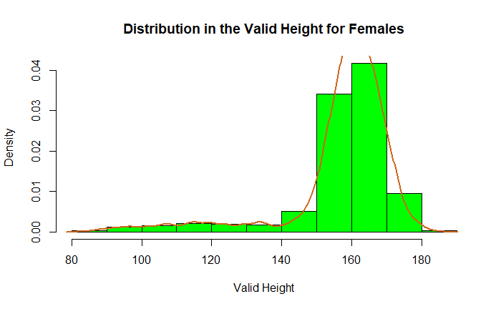
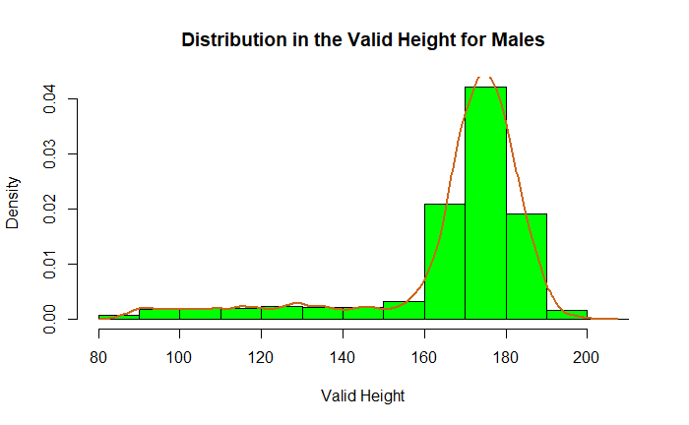
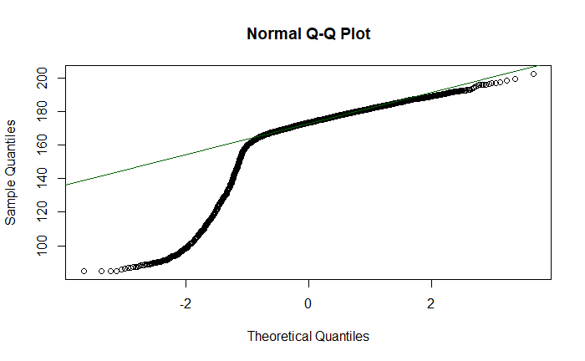
check for normal distribution in the height data
Shapiro-Wilk normality test
data: males_data$htval
W = 0.73755, p-value < 2.2e-16

Slide 15
i. Valid height
The Shapiro-Wilk normality test p-value for height is 2.2e-16, which is less than 0.05 , this means that the data does not follow a normal distribution therefore we shall use mann-whitney u test
Null Hypothesis (H0): There is no difference in height between men and women.
Alternative Hypothesis (H1): There is a difference in height between men and women.

Slide 16
Summary
wilcox.test(htval ~ Sex, data = height_weight)
Wilcoxon rank sum test with continuity correction
data: htval by Sex W = 14713021, p-value < 2.2e-16 alternative hypothesis: true location shift is not equal to 0
The p-value is 2.2e-16 which is less than 0.05, we reject the null hypothesis and say that the difference in height is statistically significant between males and females

Slide 17
Investigate whether there is a statistical difference between men and women on the following variables: i. Valid weight
Null Hypothesis (H0): There is no difference in weight between men and women.
Alternative Hypothesis (H1): There is a difference in weight between men and women.

Slide 18
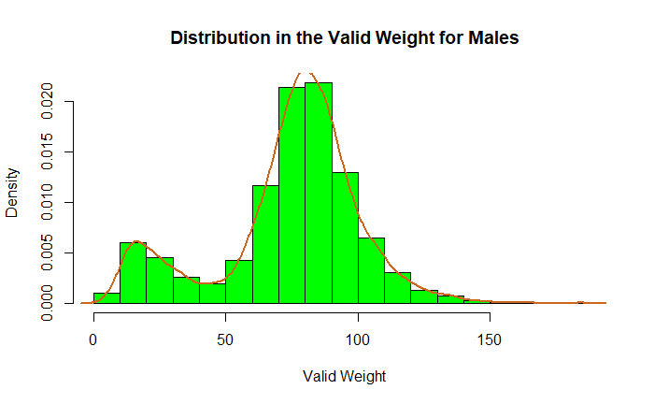
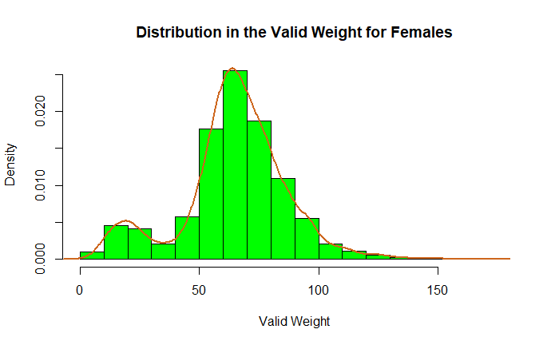
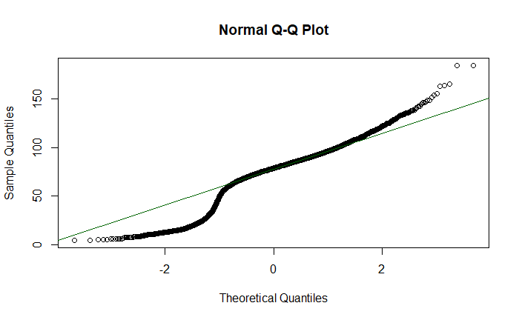
check for normal distribution in the weight data
Shapiro-Wilk normality test
data: males_data$wtval
W = 0.93674, p-value < 2.2e-16

Slide 19
Wilcoxon rank sum test with continuity correction data: wtval by Sex W = 12449400, p-value < 2.2e-16 alternative hypothesis: true location shift is not equal to 0
The p-value is 2.2e-16 which is less than 0.05, we reject the null hypothesis and say that the difference in weight is statistically significant between males and females

Slide 20
What is the correlation between whether a person drinks nowadays, total household income, age at last birthday and gender?
 | Drink now a days | Total household income | Age at last birthday | Gender
Drink now a days |  | r=-0.15 p-value <2.2e-16 | r=0.06 p-value = 1.871e-10 | r=0.11 p-value < 2.2e-16
Total household income | r=-0.15 p-value <2.2e-16 |  | r=-0.04 p-value = 1.125e-05 | r=-0.04 p-value = 2.172e-05
Age at last birthday | r=0.06 p-value = 1.871e-10 | r=-0.04 p-value = 1.125e-05 |  | r=0.032 p-value = 0.0007558
Gender | r=0.11 p-value < 2.2e-16 | r=-0.04 p-value = 2.172e-05 | r=0.032 p-value = 0.0007558

Slide 21
Correlation summary
• drinks now days and total household income
The sample estimate of the Spearman correlation coefficient is -0.15 indicating a is a weak negative association between the two variables.
• drinks now days and age at last birthday
The sample estimate of the Spearman correlation coefficient is 0.06 indicating a weak positive correlation between the two variables
• drinks now days and gender
The sample estimate of the Spearman correlation coefficient is -0.11 indicating a weak negative correlation between drinks now days and gender
• household income and age at last birthday
The sample estimate of the Spearman correlation coefficient is -0.04 indicating a weak negative correlation between total household income and age at last birthday
• total household income and gender
The sample estimate of the Spearman correlation coefficient is -0.04 indicating a weak negative correlation between total household income and gender
• age at last birthday and gender
The sample estimate of the Spearman correlation coefficient is 0.032 indicating a weak positive correlation between age at last birthday and gender
In summary, all the p-values are less than 0.05 so we reject the null hypothesis of no correlation between the variables.

Slide 22
A discussion of findings with reference to relevant literature on gender and alcohol in the UK
There is larger reductions in alcohol consumption rates among men at a 5.3% rate (Meier et al.,2021)
Arsalan et al. (2016) argue that there is a consistent rise in alcohol consumption among women
According to Davoren et al. (2016), there is notable narrowing of the gender gap in alcohol consumption in the United Kingdom
The correlation coefficient of -0.11 of the Health Survey for England, 2011 dataset's results indicates a weak relationship which is consistent with literature
Notes:
Moinuddin, A., Goel, A., Saini, S., Bajpai, A. and Misra, R., 2016. Alcohol consumption and gender: a critical review. J Psychol Psychother, 6(3), pp.1-4.
Davoren, M.P., Demant, J., Shiely, F. and Perry, I.J., 2016. Alcohol consumption among university students in Ireland and the United Kingdom from 2002 to 2014: a systematic review. BMC public health, 16(1), pp.1-13.
Meier, P.S., Holmes, J., Brennan, A. and Angus, C., 2021. Alcohol policy and gender: a modelling study estimating gender‐specific effects of alcohol pricing policies. Addiction, 116(9), pp.2372-2384.

Slide 23
Conclusion
There are gender differences in alcohol consumption patterns.
The gender gap in alcohol consumption has been narrowing over time (Meier et al.,2021).
Recommendation
Further research and evidence-based interventions are needed
The complex relationship between gender and alcohol consumption should be addressed
There is need to mitigate associated health risks.
Public health efforts should focus on raising awareness
Rising trend of alcohol consumption among women should be combated (Fitzgerald et al., 2016).
Notes:
Fitzgerald, N., Angus, K., Emslie, C., Shipton, D. and Bauld, L., 2016. Gender differences in the impact of population‐level alcohol policy interventions: evidence synthesis of systematic reviews. Addiction, 111(10), pp.1735-1747.

Slide 24
References
Collis, J., Grayson, A. and Johal, S., 2010. Econometric analysis of alcohol consumption in the UK. London: HM Revenue & Customs.
Rajput, S.A., Aziz, M.O. and Siddiqui, M.A., 2019. Social determinants of Health and Alcohol consumption in the UK. Epidemiology, Biostatistics, and Public Health, 16(3).
Office for Health Improvement & Disparities, 2023. Local Alcohol Profiles for England: short statistical commentary. Available at https://www.gov.uk/government/statistics/local-alcohol-profiles-for-england-lape-march-2023-update/local-alcohol-profiles-for-england-short-statistical-commentary-march-2023. Accessed [Feb, 2024]
Kabacoff, R., 2022. R in action: data analysis and graphics with R and Tidyverse. Simon and Schuster.
Moinuddin, A., Goel, A., Saini, S., Bajpai, A. and Misra, R., 2016. Alcohol consumption and gender: a critical review. J Psychol Psychother, 6(3), pp.1-4.
Davoren, M.P., Demant, J., Shiely, F. and Perry, I.J., 2016. Alcohol consumption among university students in Ireland and the United Kingdom from 2002 to 2014: a systematic review. BMC public health, 16(1), pp.1-13.
Meier, P.S., Holmes, J., Brennan, A. and Angus, C., 2021. Alcohol policy and gender: a modelling study estimating gender‐specific effects of alcohol pricing policies. Addiction, 116(9), pp.2372-2384.
Fitzgerald, N., Angus, K., Emslie, C., Shipton, D. and Bauld, L., 2016. Gender differences in the impact of population‐level alcohol policy interventions: evidence synthesis of systematic reviews. Addiction, 111(10), pp.1735-1747.

Slide 25
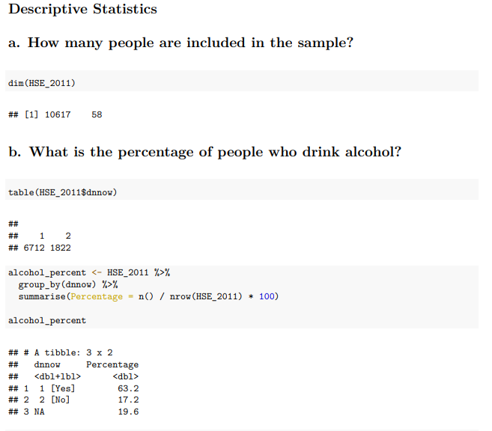
Appendix 1
Descriptive Statistics

Slide 26
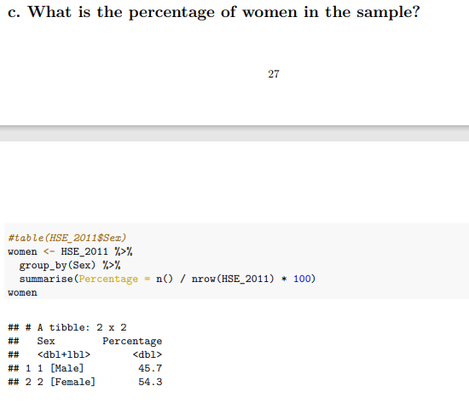
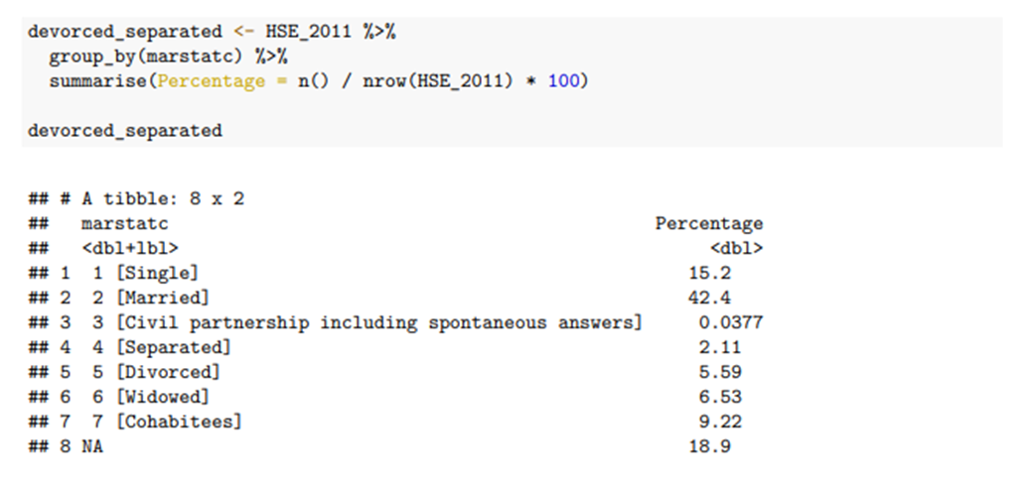

Slide 27
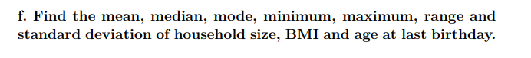
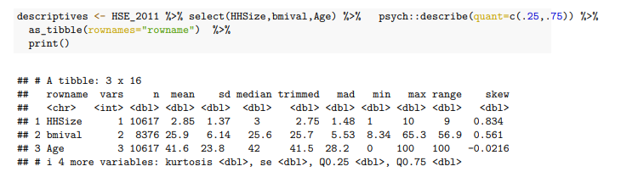
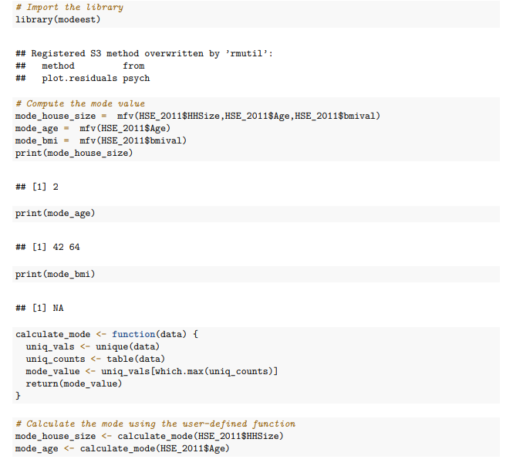

Slide 28
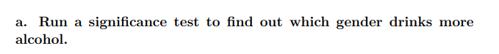
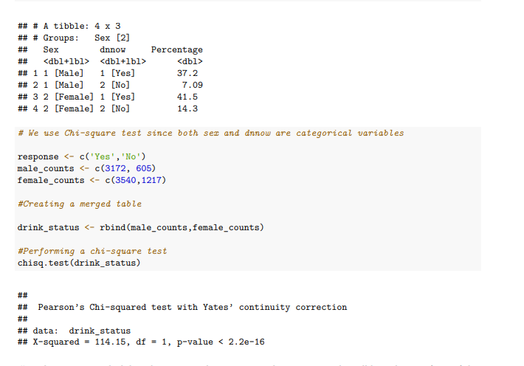
Appendix 2
Chi-square

Slide 29
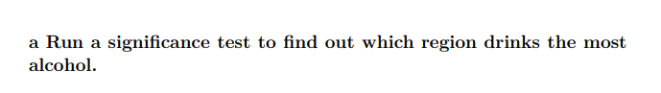
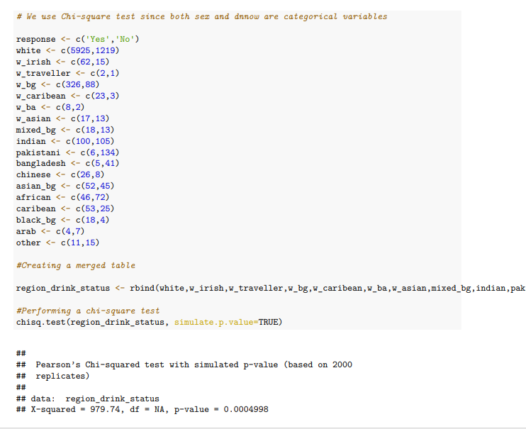

Slide 30
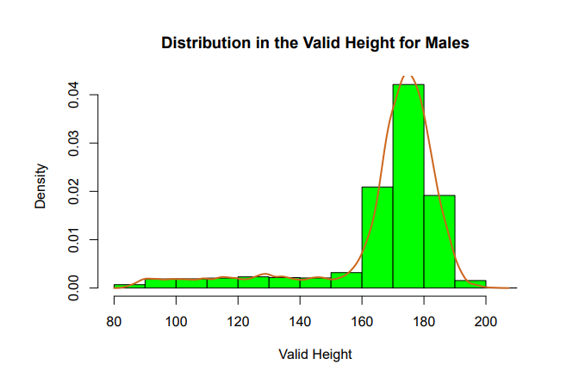
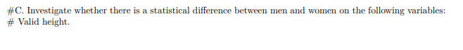
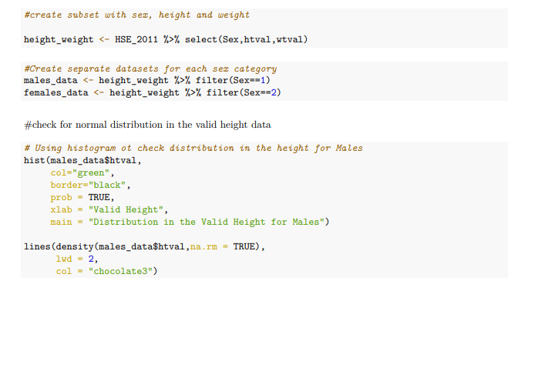
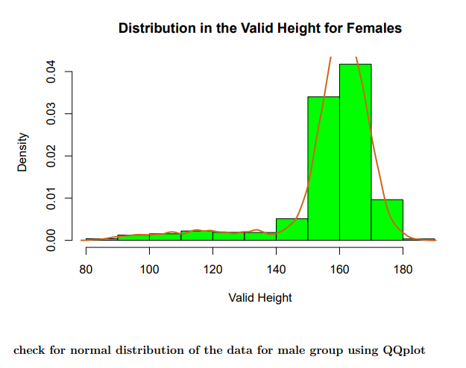
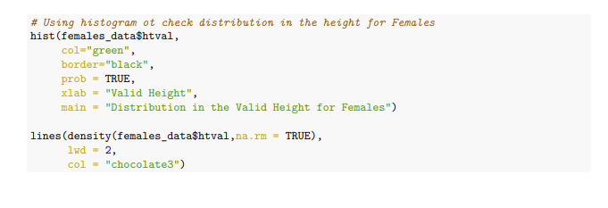
Appendix 3 Normality Test and Mann-whitney U test

Slide 31
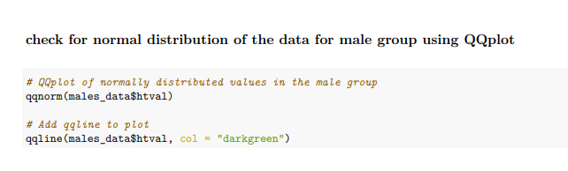
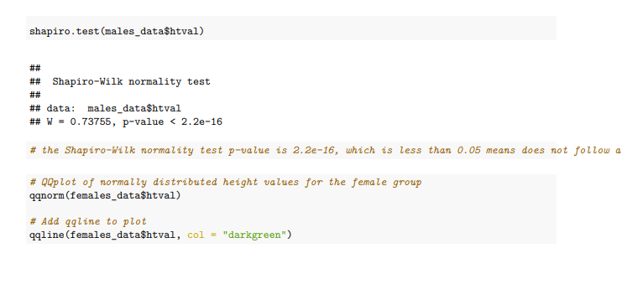
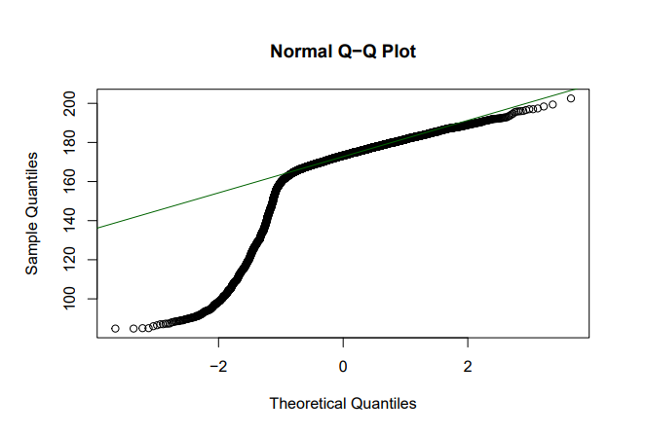

Slide 32
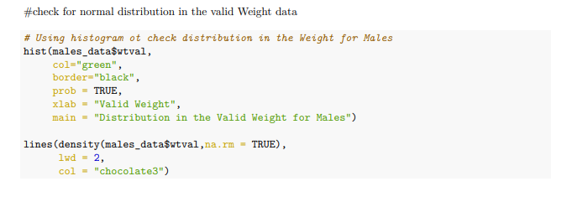
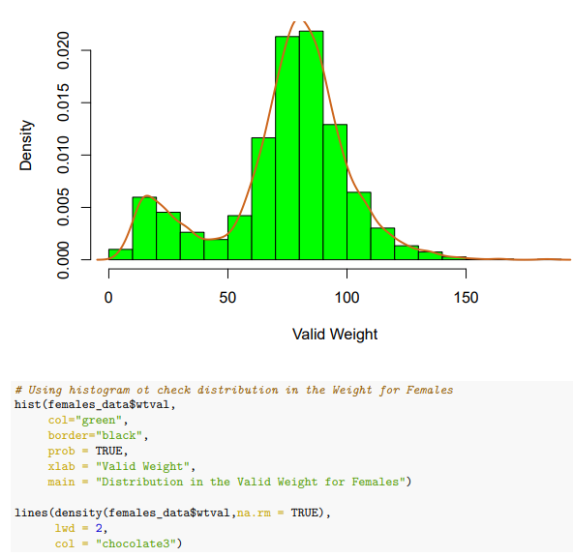
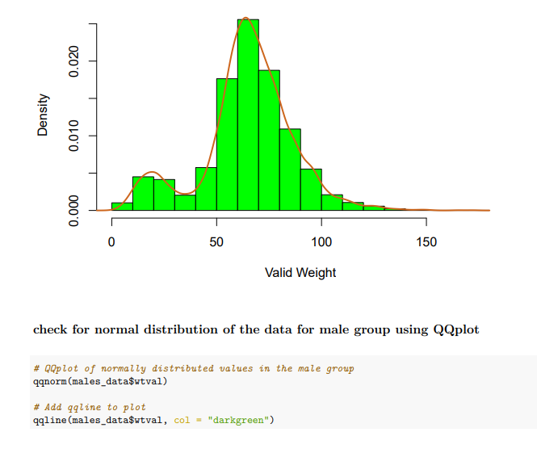

Slide 33
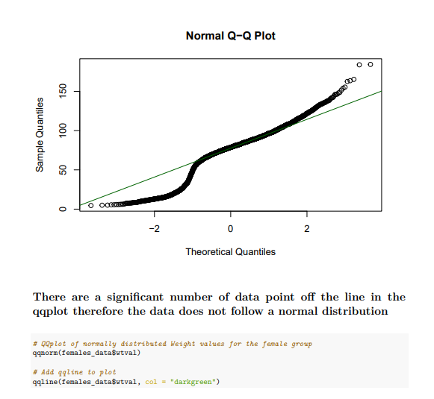
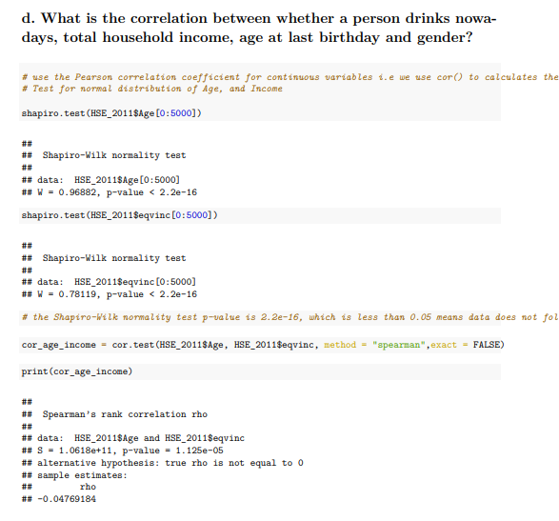

Slide 34
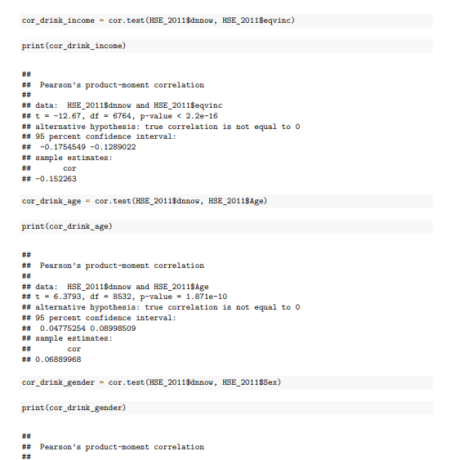
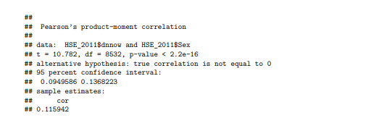
Appendix 4 Correlation

Slide 35
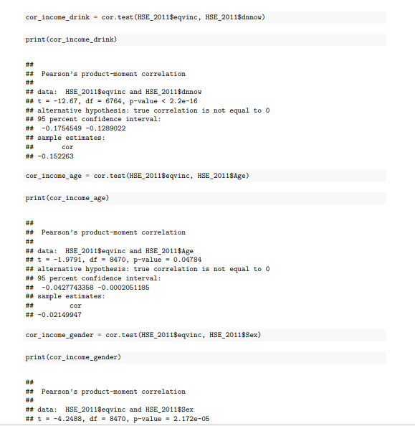
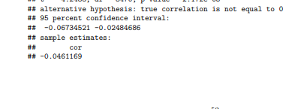

Slide 36
